Slide 1
Spark Installation Tutorial
Hemeng Tao

Slide 2
Java Installation
If you already have java installed, please skip this step.
Go to http://www.oracle.com/technetwork/java/javase/downloads/jdk8-downloads-2133151.html to download Java SE Development Kit 8u144. Remember to accept agreement and select Linux x64 jdk-8u144-linux-x64.tar.gz
Go to directory where you store the file and enter the command as shown in right figure.

Slide 3
Java Installation
Rename jdk folder following commands in right figure (please do not miss /)
Install vim by
sudo apt-get install vim

Slide 4
Java installation
Enter command (vim ~/.profile)
Enter All “export” part in the right figure at the end of this file
Press ESC, then press shift + :
Enter wq, press enter to save changes

Slide 5
Java installation
Source this file according to command in the right figure

Slide 6
JAVA INSTALLATION
Verify your installation.
Restart Ubuntu

Slide 7
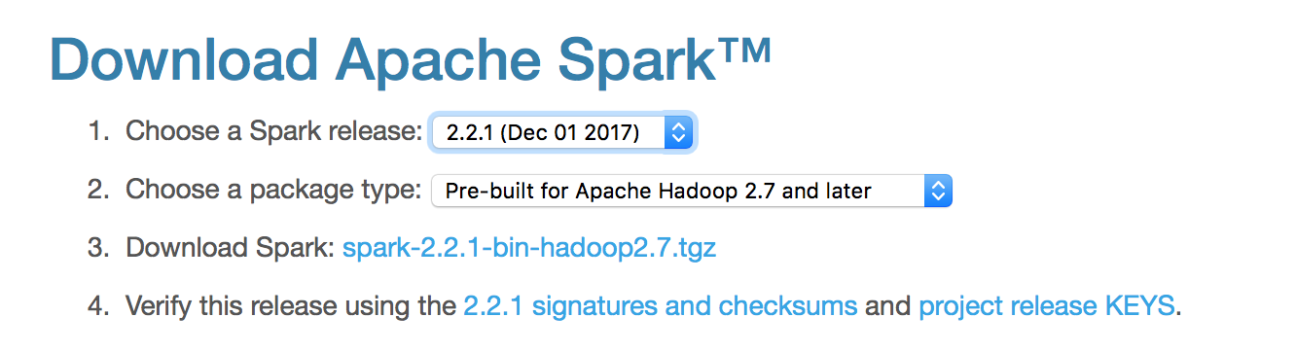


Download Spark
http://spark.apache.org/downloads.html （2.2.1 version）
Do not download the latest version
Unzip it and extract it to a directory by double clicking the tgz file and extract it
Rename the spark directory
﻿mv ~/Downloads/spark-2.2.0-bin-hadoop2.7/ ~/Documents/spark/ （please do not miss /）
Add path to environment variables by adding the following command in your ~/.profile
vim ~/.profile
﻿export PATH=$PATH:/home/alan/Documents/spark/bin (change to your own directory)
Save it by press <ESC> and enter :wq, then hit enter
Run following command
source ~/.profile

Slide 8
PYTHON INSTALLATION
PyCharm Installation https://www.jetbrains.com/pycharm/download/#section=mac for mac
https://www.jetbrains.com/pycharm/download/#section=linux for linux
Download the community version. Unzip downloaded file and install it. Open a terminal and type python -- version to check your current python version
Download Anaconda
https://www.anaconda.com/download/#macos for mac
https://www.anaconda.com/download/#linux for linux
Note that Pyspark supports Python 2.7+/3.4+
Install Anaconda and make sure at the end of installation, let anaconda modify your PATH variable by adding anaconda path in front of your PATH variable

Slide 9
PYTHON INSTALLATION

Slide 10

PYTHON INSTALLATION
Close current terminal and re-open a new terminal
PySpark has been merged into repository. to use pyspark only, simply install it using following command

Slide 11
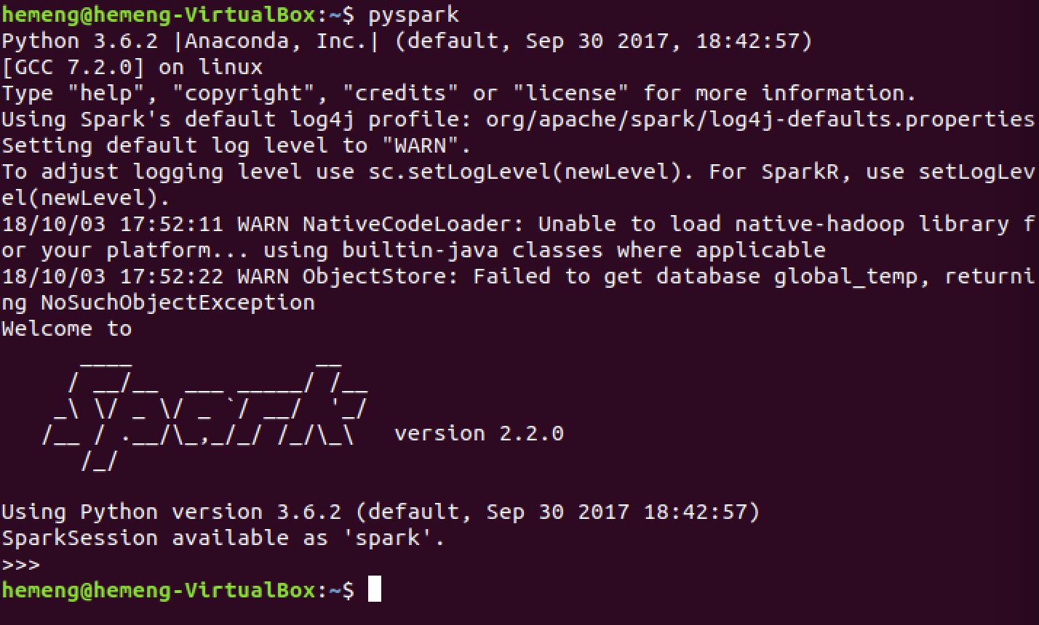
Test Spark
Run pyspark
Ctrl+D to exit spark

Slide 12
TEST PYSPARK
Open pycharm, create a new project named WordCount and a python file.
Add the interpreter:
File->settings->project:wordcount->project interpreter: add interpreter ~/anaconda3/bin/python3.6
Then run wordcount.py

Slide 13
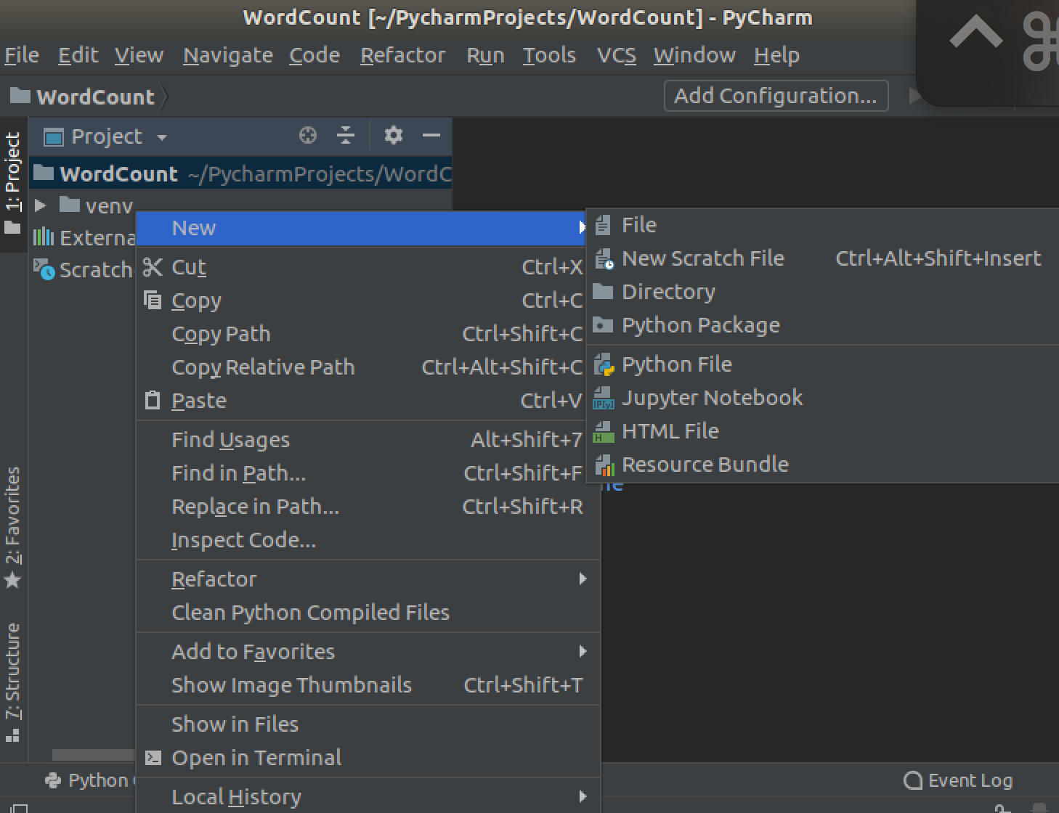
TEST PYSPARK

Slide 14
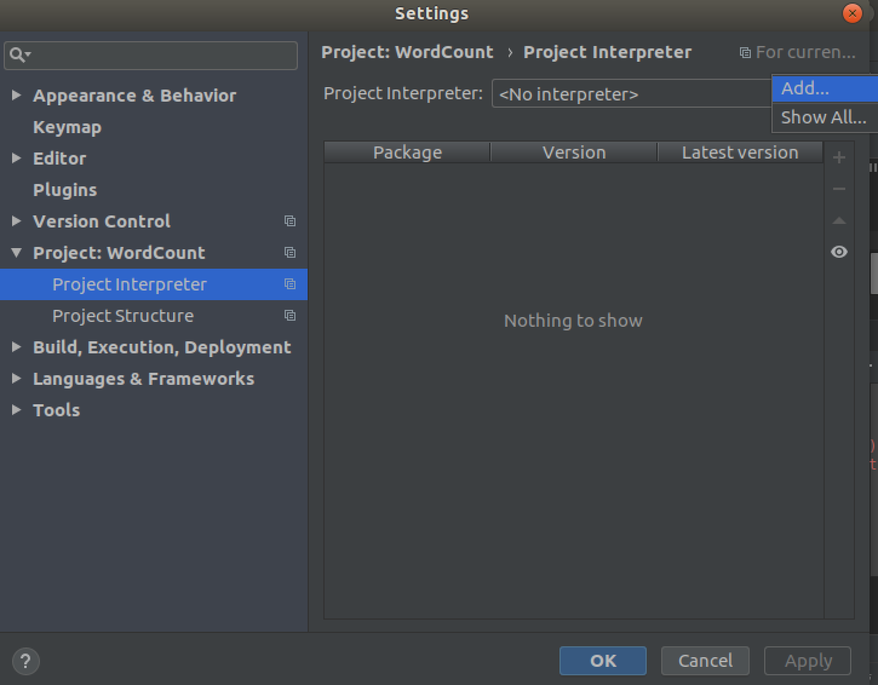
TEST PYSPARK

Slide 15
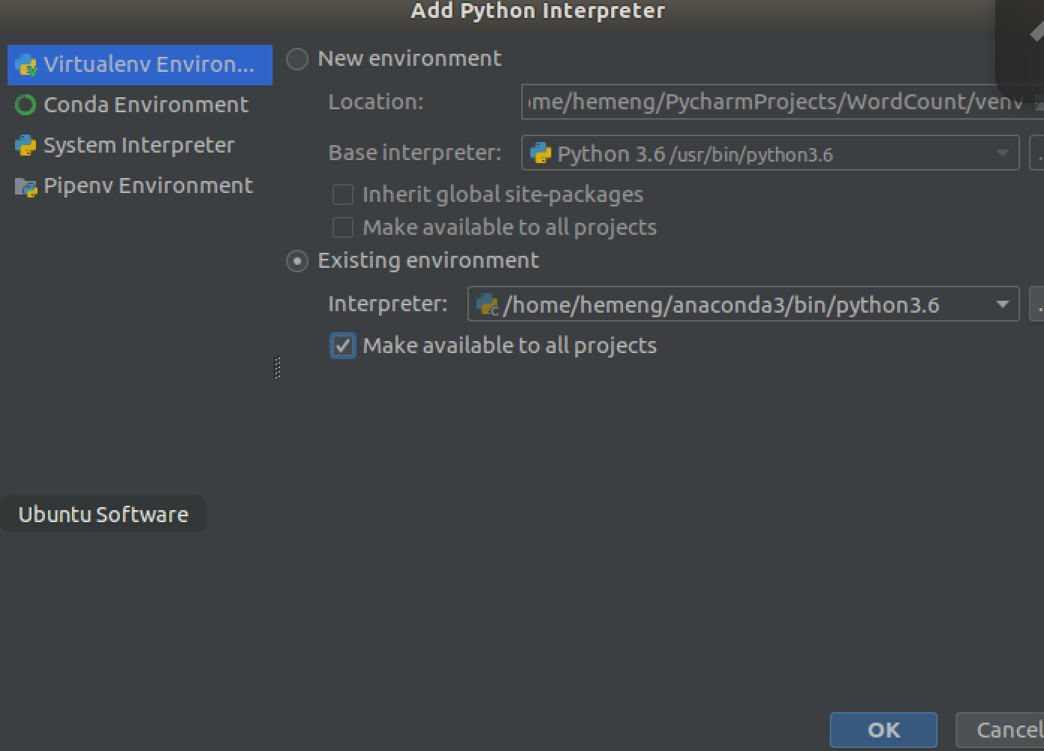
TEST PYSPARK

Slide 16
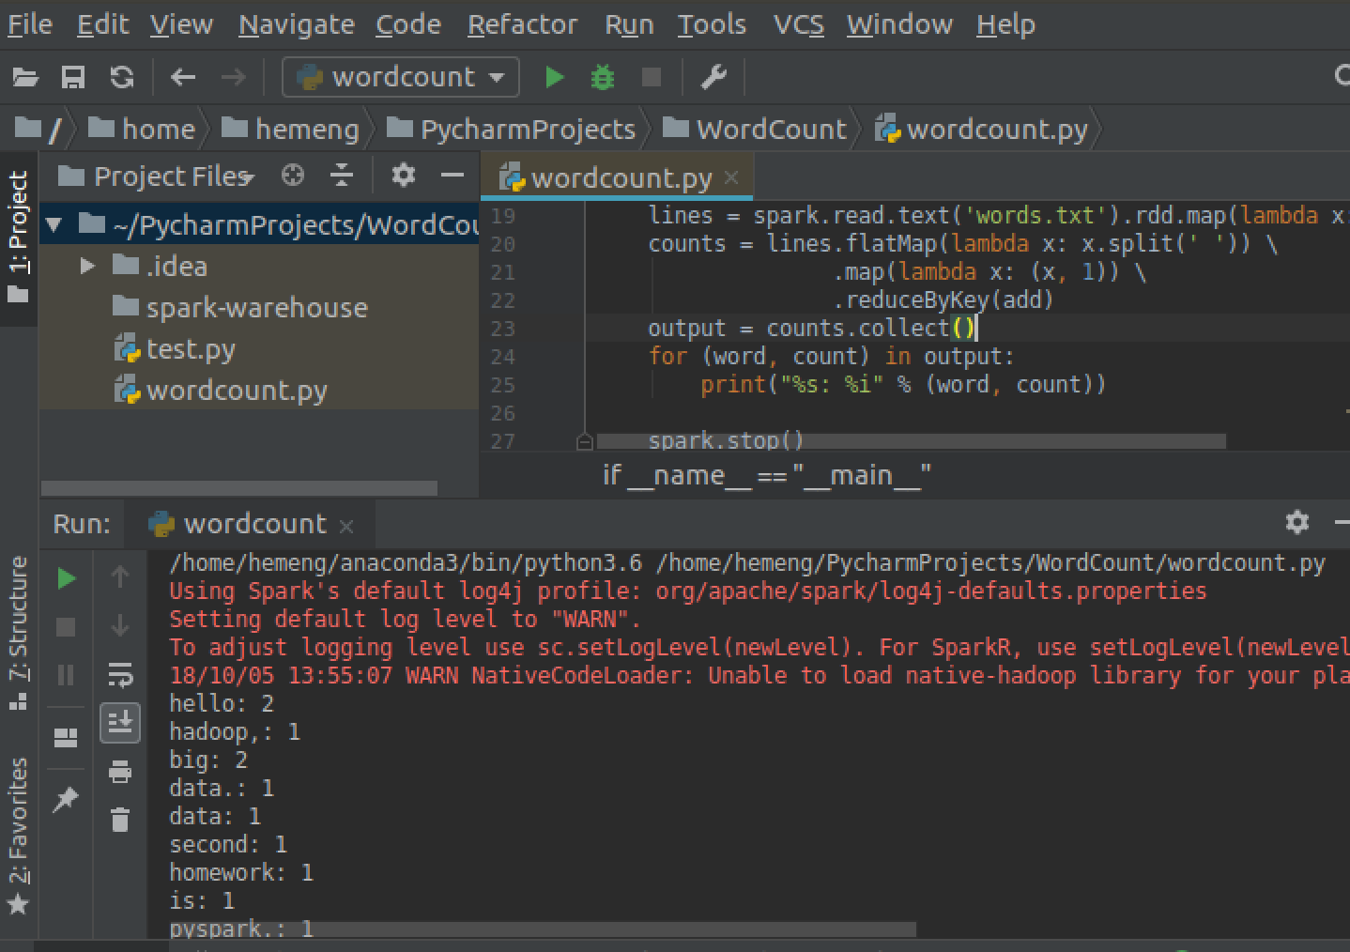
TEST PYSPARK

